Slide 1
Disruption Index – Measuring Moments that Break Structure
A new lens on football actions that bend defensive shape
Kevin Kang
Notes:
Hi everyone — my name is Kevin Kang, and today I’m excited to introduce a new way of thinking about player impact in football.
It’s called the Disruption Index — and it focuses not on what happens at the end of a play, but what happens just before everything breaks down.
This version focuses on the back line: the foundation of defensive shape.
“Right now, we define structure as the defensive line. That’s the cleanest signal of tactical disruption, and it’s where coaches look first when shape collapses.”

Slide 2
AGENDA
The Problem
The Idea
How It Works (Conceptually)
Visual Example #1 - High Disruption
Visual Example #2 - Low Disruption
Early Insights
Use Cases
What’s Next
Closing Message
Notes:
We'll walk through the problem, the core idea, how we built it, and what this metric could unlock for scouting, tactics, and analytics.

Slide 3
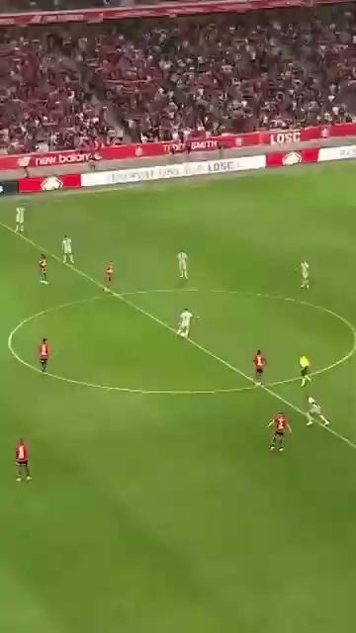
MOST METRICS STOP AT THE FINAL ACTION
xG, XT, and assists measure outcomes
But many game-breaking actions happen earlier
No existing metric captures disruption to defensive structure
Notes:
Let’s start with the gap. Most metrics in football — xG, xT, assists — measure outcomes. They tell you who created the goal, who made the final pass, who generated threat. But often, the most important moment happens earlier. A run that pulls defenders out. A switch pass that forces a reshuffle. A carry that disturbs spacing. These are the moments that cause defenses to break. And right now — there’s no metric that captures this disruption. Nothing that measures the ripple effects that happen before the final ball. This is where our work begins — capturing the value of *structure-breaking actions* that usually go unseen.
This player creates chaos. He doesn’t touch the ball. Doesn’t assist. Doesn’t even show up in the xG chain. But he changes everything.
We wanted to quantify moments like these.

Slide 4
INTRODUCING THE DISRUPTION INDEX
Measures how much an action destabilizes a defense
Focuses on what happens after the action:
How far defenders move
Shape deformation
Time until structure recovers
Doesn’t require a goal or assist to be valuable
Notes:
So what is the Disruption Index? It’s a new lens — one that focuses on how much a single action destabilizes a defense. Instead of just measuring expected threat or goal likelihood, it measures: how far defenders move, how the defensive line deforms, and how long it takes to recover shape. The key insight is that even without a shot or a goal, an action can bend the structure of the game — and we can quantify that impact. This isn’t a replacement for xT or xG — it’s a complement. A different dimension of value: chaos, stress, distortion of shape.
Right now, we focus on the structure of the defensive line. That’s the cleanest signal of tactical disruption, and it’s where coaches look first when shape collapses.
In your clip:
The cm plays a long ball to the lw - > one moment of disruption
rcb out of position has to slide inside while the central cb pulls out wide
the lw plays a through ball to the runner coming in -> another moment of disruption
“The idea is simple — we track the ripple effect of a football action. If xT looks at where the ball goes, Disruption Index looks at what the defenders do in response.”
We track defensive structure over time — looking at how it stretches, breaks, and reforms. The metric is agnostic to whether a goal happens. It cares about chaos.
So to xT, the striker’s impact = 0.00.
But to our metric, it’s high disruption — shape breaks, recovery delay, defensive shift.
We tested whole-team disruption using average displacement and shape variance, but ultimately focused on the defensive line for clearer tactical interpretation. “We absolutely want to extend this to whole-team disruption, including midfield compactness and coordination. But we started with the back line because that’s where structure is most stable and most visible. Think of it as the spine of the shape — if that breaks, everything else follows.”

Slide 5
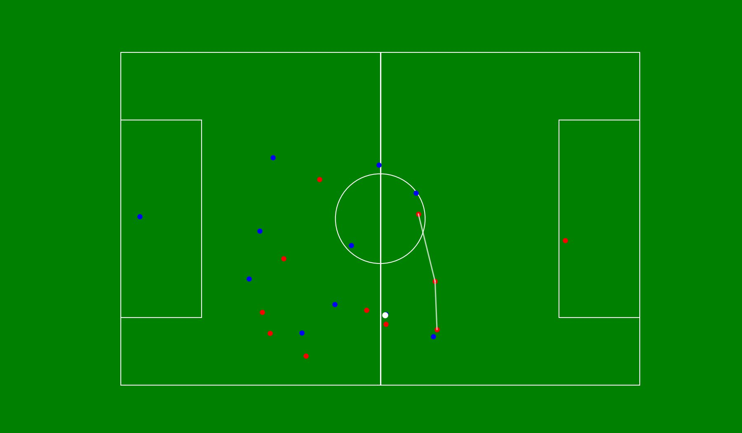
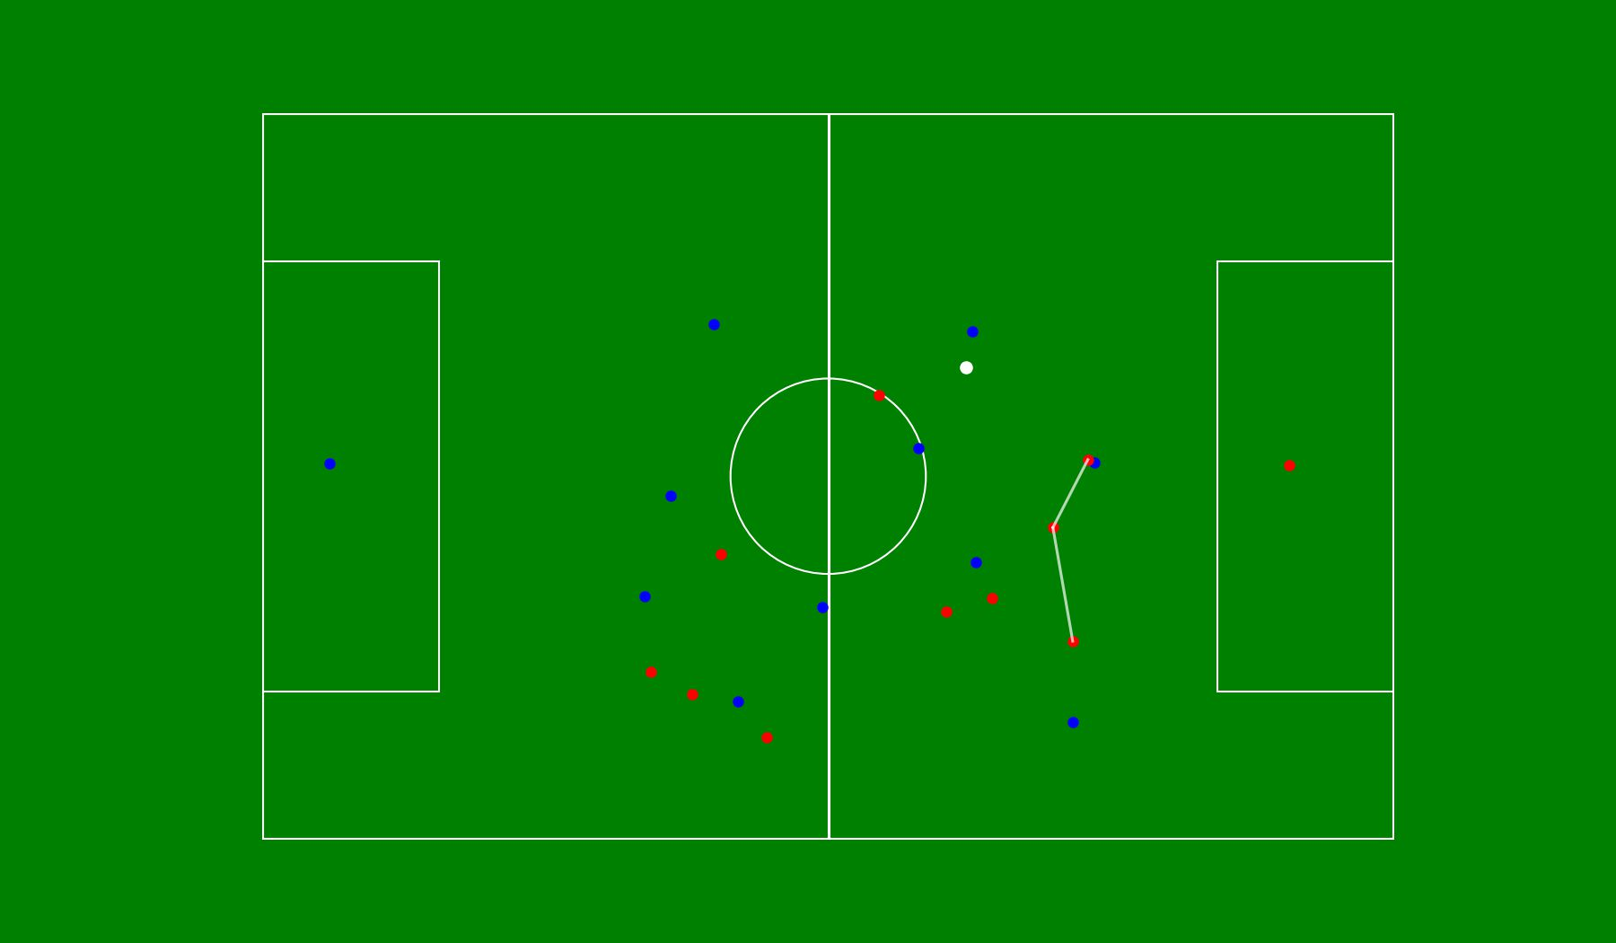
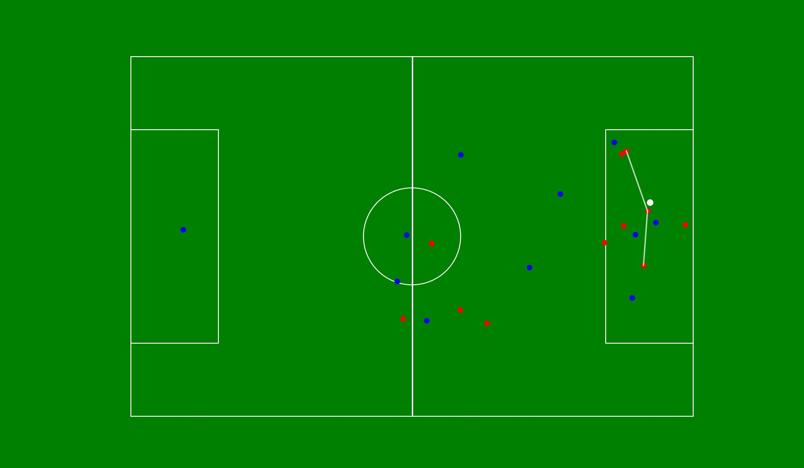
CALCULATING DISRUPTION
Identify moment of action
Select frame t (e.g. start of pass, run, or decoy)
Track defenders’ positions for N frames
Quantify:
Δ Width - how far the back line stretches
Δ Dispersion - how spread out the defenders become
Recovery time - how long until shape reforms
Output a Normalized Disruption Score [0-1]
Higher = more destabilizing to defensive shape
Before
Peak Disruption
After
Notes:
Let me break down how it works under the hood. We start by identifying a moment of interest — this could be the beginning of a pass, a dribble, or even a decoy run. That moment is labeled Frame t. From there, we track defenders — specifically the back line — over the next few seconds. We measure three things: - Δ Width: how much the line stretches - Δ Dispersion: how spread out the defenders become - Recovery Time: how long it takes to return to compact shape Those three factors are then normalized and combined into a single Disruption Score between 0 and 1. Higher scores mean greater structural impact — more chaos introduced into the shape of the opponent.
we have max shape deformation is delta width Δ Width (meters) Interpretation -> change in defensive line width
definition: The horizontal spread (in meters) of the defensive line after the disruption, minus the baseline width before it.
formula: Δ Width = max(xₜ...xₜ₊ₙ) - min(xₜ...xₜ₊ₙ) - (max(xₜ₋₁) - min(xₜ₋₁))
Where:
x values are player x-positions in meters (already metric)
Measured for 3–5 defensive players
Before frame: frame_before = 500 After frame: max width in window 501–540 (approx. 2s post-action)
< 2.5m 🟢 Low – no real structural shift 2.5–7.5m🟡 Moderate – pulled slightly > 7.5m🔴 High – full back line shifted
Recovery Time Interpretation -> time until width returns close to baseline
definition: The time (in seconds) it takes for the defensive line width to return close to the original shape.
threshold = “Close” = within ±2m of original width (you can justify tuning this)
< 2s 🟢 Quick — not meaningful 2–5s 🟡 Moderate disruption > 5s 🔴 Sustained structural break -> tactically exploitable
disruption_score -> normalized scalar [0,1]
definition: A single value that represents how much the defense was destabilized, normalized to [0, 1].
Design Choice: You combine:
Magnitude (Δ Width)
Duration (Recovery Time)
formula: min(1.0, (delta_width / 10) + (recovery_time / 10))
This means:
10m width shift + 0s = 1.0
5m width shift + 5s recovery = 1.0
2m shift + 1s = 0.3 → low
Score Label Meaning
< 0.4 🟢 Low Disruption (Noise, not threat) 0.4–0.7🟡 Medium Disruption (Possibly valuable, deserves review)
> 0.7🔴 High Disruption (A moment of chaos — “game-changing potential”)
This means:
10m width shift + 0s = 1.0
5m width shift + 5s recovery = 1.0
2m shift + 1s = 0.3 → low
You’re combining both spatial and temporal disturbance, which is what makes this metric unique.
💡 You can justify this as a linear combination of normalized effects, and even propose weighting if challenged:
disruption_score = min(1.0, w1 * (delta_width / 10) + w2 * (recovery_time / 10))
Where w1 = 0.5, w2 = 0.5 for now.
“Why max width?”
Because it’s simple, interpretable, and robust to noise. Coaches can see back lines widen.
“Why 2m recovery threshold?”
Because teams are trained to maintain compactness — ±2m is enough to allow for small fluctuations but still detect structure reset.
“Why 10 as the divisor?”
Because 10 meters is approximately half the width of the penalty box, which visually feels like a major shift. Also normalizes to [0, 1].
Why not use xT?
Because xT measures goal threat. Disruption measures shape breakage. They often overlap — but not always. This model picks up the pre-threat chaos.

Slide 6
EXAMPLE: WHEN STRUCTURE BREAKS
Δ width
2.02m
Δ dispersion
2.86m
Recovery time
4.4s
Disruption Score
0.93
Notes:
Here’s an example of high disruption in action. Watch as the defense gets pulled apart — the line stretches, gaps form, and the team struggles to recover shape. In this moment, there’s no shot. No assist. But the structure is clearly broken — and that matters.
Here’s what happens: the striker drops into midfield to receive. It’s a simple layoff — nothing flashy — but it pulls the right center-back out of position. That single movement opens up space for the left winger to attack, leaving the entire right side of the defense exposed.
The Disruption Score here is 0.93 — one of the highest we've seen. This is a perfect example of a player creating value not through output, but through distortion — forcing emergency reactions that echo into the next phase of play.
frame 500 to 620

Slide 7
EXAMPLE: NOT ALL MOVEMENT CREATES CHAOS
Δ width
1.30m
Δ dispersion
1.33m
Recovery time
0.5s
Disruption Score
0.31
Notes:
Now let’s look at a contrasting example. Same type of action — a pass or movement through the same area of the pitch. But here, the defensive line holds. The structure remains compact. There’s a response, but it’s immediate and controlled. The Disruption Score is much lower — around 0.31. This is a great illustration that not all progressive actions are equal. Some produce clear tactical stress. Others are absorbed. The Disruption Index helps us see that difference — in movement, not just outcome.
frame 1150 to 1425

Slide 8
EARLY INSIGHTS
Notes:
With just a handful of clips, we're already seeing patterns emerge. Some players or actions consistently generate higher disruption, even without contributing to xT or direct chances. In our example, a simple lay back or run tend to break structure more than simple passes but also wide overloads, aggressive carries, and third-man runs create undocumented chaos as well What’s powerful here is that this model picks up on hidden influence. Players who don’t score or assist, but create disorder that leads to downstream opportunities. These are often undervalued players — and disruption gives us a way to surface them.

Slide 9
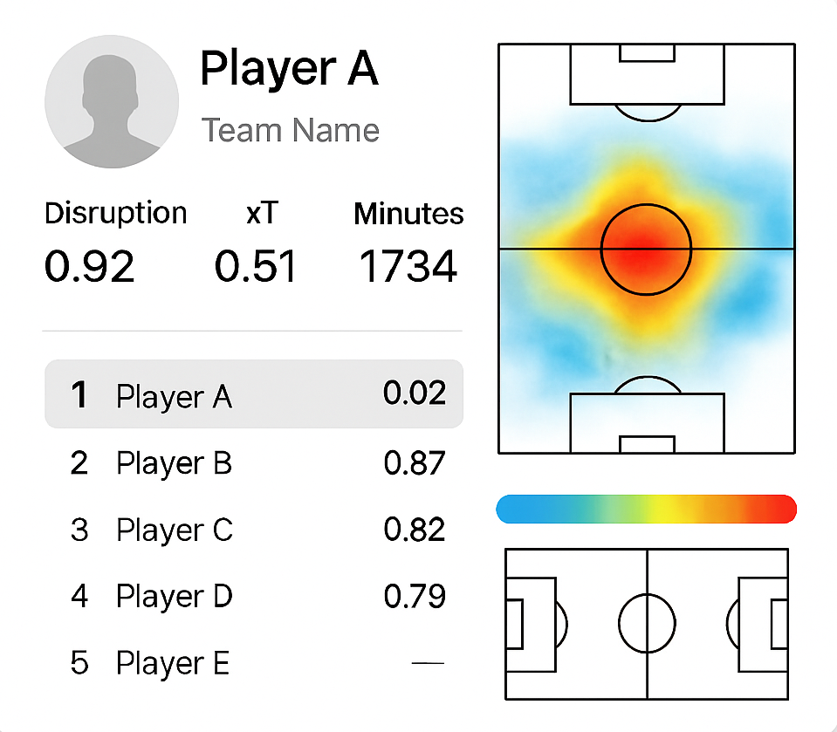
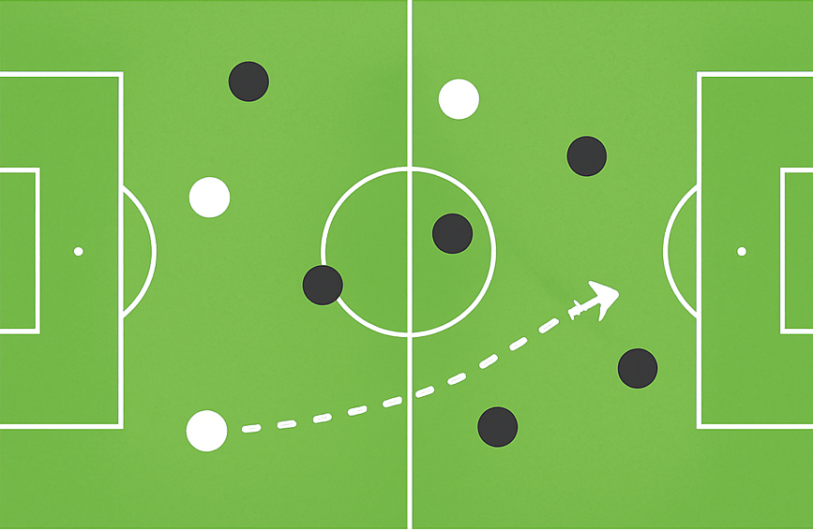
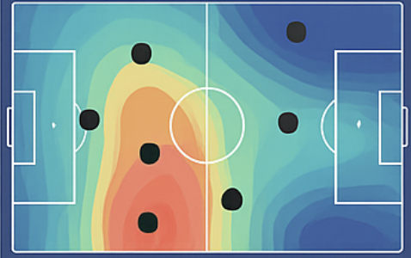
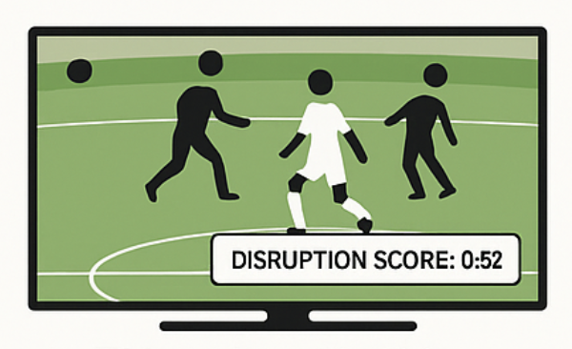
REAL-WORLD APPLICATIONS
Scouting
Tactics
Analytics
Broadcast
Spot undervalued players with disruptive impact
Pinpoint actions or triggers that reliably break structure
Add disruption as context to EPV, xT, or threat models
Highlight disruptive moments even when they don’t lead to goals
Notes:
This kind of metric has real-world applications across the game. In scouting, it helps spot undervalued players — the ones who break structure without showing up on traditional stat sheets. In tactical planning, coaches can identify triggers or movement patterns that consistently cause disruption. In analytics, disruption can be layered onto models like xT or EPV to provide richer context — showing not just where threat emerges, but what made it possible. And in broadcasting, it allows us to highlight important moments that *don’t* lead to goals — but still shift the game’s balance.

Slide 10
WHAT IS NEXT FOR THE DISRUPTION INDEX
Expand
Validate
Test
Build
Integrate
Expand beyond the back line to capture midfield rotations, pressing triggers, and off-ball chaos
Validate disruption scores against outcomes like xT, goals, and team success
Test across leagues with diverse tactical styles and defensive structures
Build real-time tooling for coaching staff and match analysts
Integrate into models like EPV or xT to provide layered tactical context
Notes:
Looking ahead, there are five key areas we’re focused on. First, expanding beyond just the back line — we want to capture disruption caused in midfield rotations, pressing traps, and transition moments. Second, validating our scores against actual outcomes — do higher disruption moments lead to more goals? More xT? Greater team success? Third, testing this across leagues — from the high press of the Bundesliga to the compact blocks of Serie A. Fourth, building real-time tooling — imagine a coach getting disruption alerts live during a match. And finally, integrating this into larger models — so that disruption becomes a layer within Expected Threat (xT), Expected Possession Value (EPV), or Value Actions by Estimating Probabilities (VAEP) frameworks.

Slide 11
Some players create chaos.
The Disruption Index is how we finally measure it.
Notes:
Some players create chaos — not through goals or assists, but by breaking structure. The Disruption Index is how we finally measure that. Thank you.
Q1: Why do we need a new metric when we already have xT or EPV? 🟢 “Because disruption happens before threat emerges. xT tells you how dangerous a location is. The Disruption Index tells you how much chaos an action caused to the opposing shape — even if it doesn’t end in a shot.”
Q2: Why combine ΔWidth, ΔDispersion, and Recovery Time? Isn’t one enough? 🟢 “Each captures a different kind of disruption — width shows stretch, dispersion captures irregular shape, and recovery time shows how long it stays broken. Combined, they reflect structured and chaotic disruption.”
📊 Validation / Scalability
Q3: Have you validated this against outcomes like xT or goals? 🟢 “That’s next — so far we’ve done visual and conceptual validation. But we’re planning to correlate disruption scores with goals, shot quality, and team performance across full matches.”
Q4: Can this scale to full matches or seasons? 🟢 “Yes — it’s fully automatable with tracking data. Once calibrated, it can score every pass or carry in near real-time.”
⚙️ Tech Questions
Q5: Can this be done with StatsBomb or event-only data? 🟢 “Only partially. We experimented with a StatsBomb-based proxy that counted opponent pressures after actions, but it doesn’t capture shape or recovery — you really need tracking data for full structural analysis.”
Q6: Why didn’t you include Voronoi in the final model? 🟢 “It’s something we explored for future work. Voronoi is great for modeling spatial control, but our current focus is on structural movement. Eventually, we’d love to combine them.”
🎯 Use Case / Application
Q7: How would a team use this in practice? 🟢 “Scouts could flag players who consistently break shape. Analysts could pair disruption spikes with threat models. Coaches could identify ‘disruption triggers’ in their own attacking patterns — or vulnerabilities in their opponents.”
Q8: Can this help youth development or recruiting? 🟢 “Absolutely — it picks up on the influence of players who don’t score or assist but shape the game tactically. It could help identify intelligent movers and chaos creators who might otherwise be overlooked.”
🟢 1️⃣ Slide Bullet (for "Methods Explored" or Appendix)
🧪 We tested whole-team disruption using average displacement and shape variance, but ultimately focused on the defensive line for clearer tactical interpretation.
🟢 1️⃣ Spoken Sentence (if asked or during Q&A)
“We explored metrics like average player displacement and shape variance across the full team, but found that backline behavior — especially stretching and recovery — gave us a cleaner, more explainable signal of structural disruption that matched what coaches intuitively see.”
🤔 Q: “Why only the back line and not the midfield?”
✅ Answer (spoken):
“Great question. The back line is the team’s structural anchor — if it breaks, the whole shape breaks. Midfielders are expected to move dynamically — pressing, switching, covering — so their positional spread can fluctuate without necessarily indicating disruption. We wanted to isolate true structural instability, and the back four or five provides the most stable baseline for that. That said, we’re very interested in extending this to midfield compactness as a future layer.”
🔁 Optional follow-up if you want to sound research-minded:
“We're also considering hierarchical disruption — where we track cascading effects from back line to midfield — but this first version focuses on clean, explainable triggers.”

